Slide 1
ME 165
Basic Mechanical Engineering
Lecture 05
Equilibrium of Rigid Bodies
Sadia Tasnim
Lecturer
Department of Mechanical Engineering, BUET

Slide 2
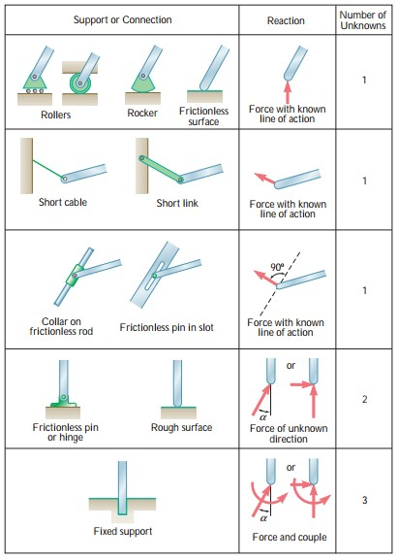
Equilibrium of Rigid Bodies in 2-D
Reactions at Supports and Connections for 2-D Structure

Slide 3
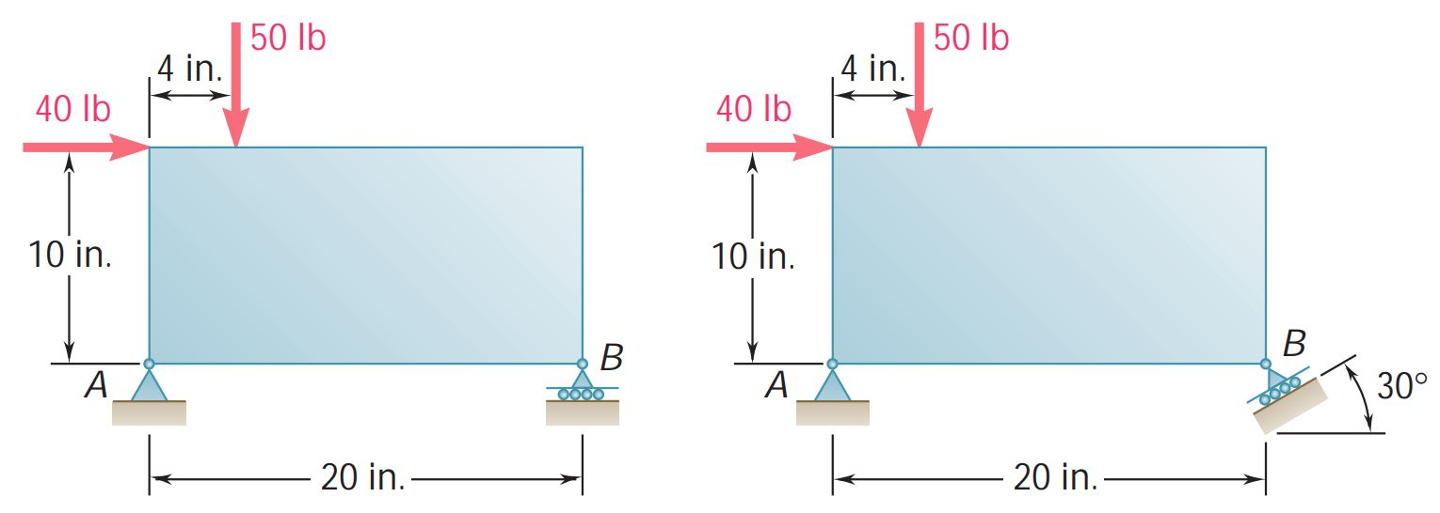
Conditions of Equilibrium in 2D
Problem 1:
For each of the plates and loadings shown, determine the reactions at A and B.

Slide 4
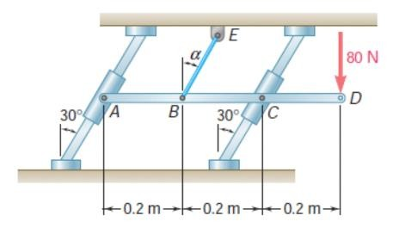
Conditions of Equilibrium in 2D
Problem 2:
Bar AD is attached at A and C to collars that can move freely on the rods shown. If the cord BE is vertical (α = 0), determine the tension in the cord and the reactions at A and C.

Slide 5
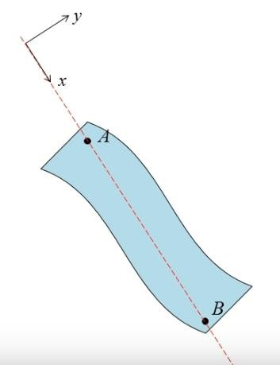
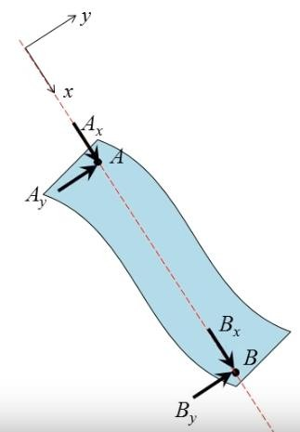
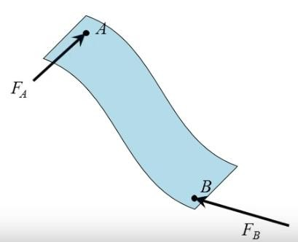
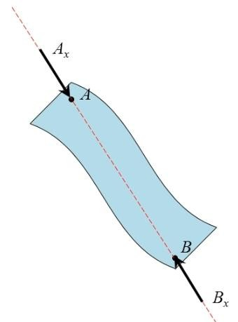



Equilibrium of Two force Body: Forces acting at only 2 points
Two Forces:
Same magnitude
Opposite Direction
Same line of action

Slide 6

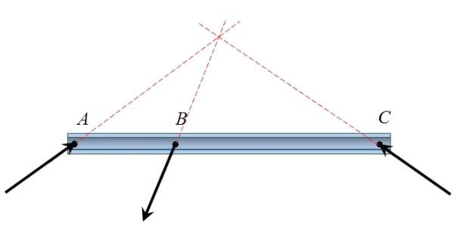
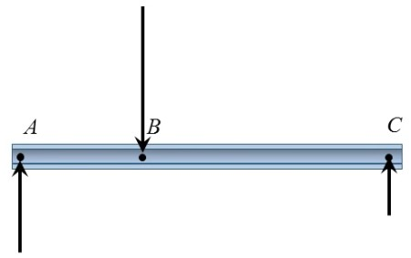
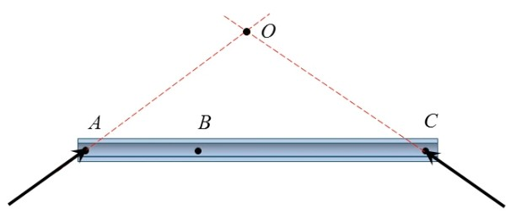
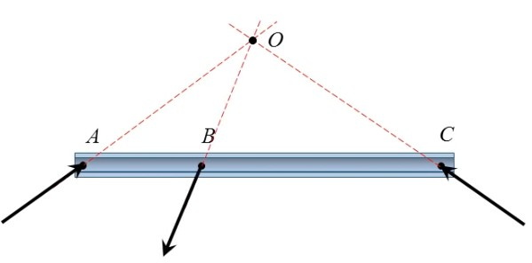

Equilibrium of Three force Body

Slide 7
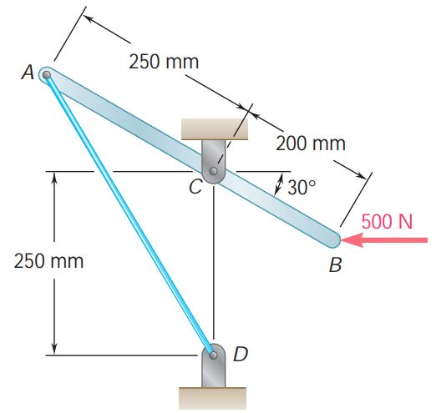
Problem 3:
The lever AB is hinged at C and attached to a control cable at A. If the lever is subjected at B to a 500 N horizontal force, determine
(a) the tension in the cable,
(b) the reaction at C.

Slide 8
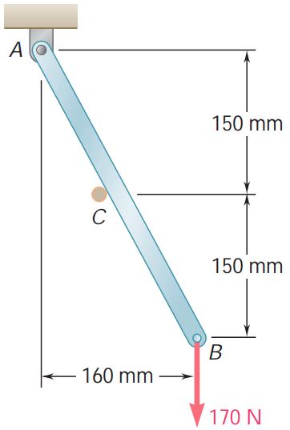
Problem 4:
Rod AB is supported by a pin and bracket at A and rests against a frictionless peg at C. Determine the reactions at A and C when a 170-N vertical force is applied at B.

Slide 9
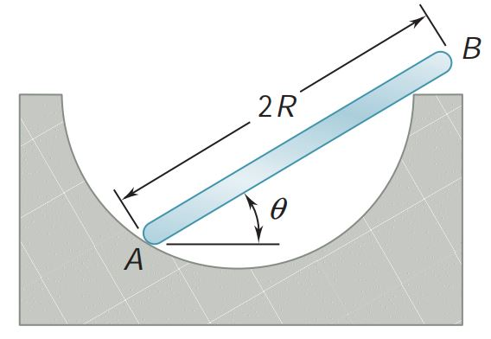
Problem 5:
A uniform rod AB of length 2R and weight W rest inside a hemispherical bowl of radius R as shown. Neglecting friction, determine the angle θ corresponding to equilibrium.

Slide 10
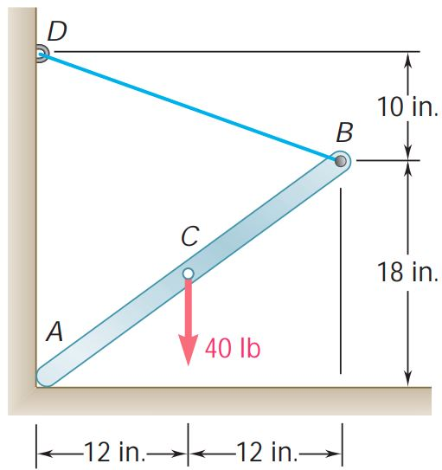
Problem 6:
One end of rod AB rests in the corner A and the other end is attached to cord BD. If the rod supports a 40-lb load at its midpoint C, find the reaction at A and the tension in the cord.

